Slide 1
Types of photo shots
An introduction to
training your eyes to take better photos
with your phone.

Slide 2


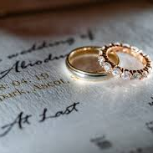
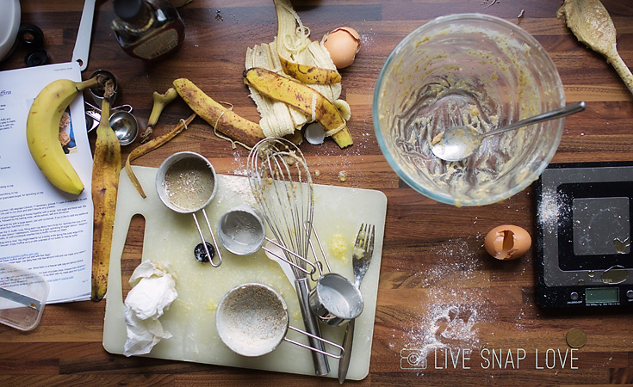

DETAILS with OBJECTS

Slide 3
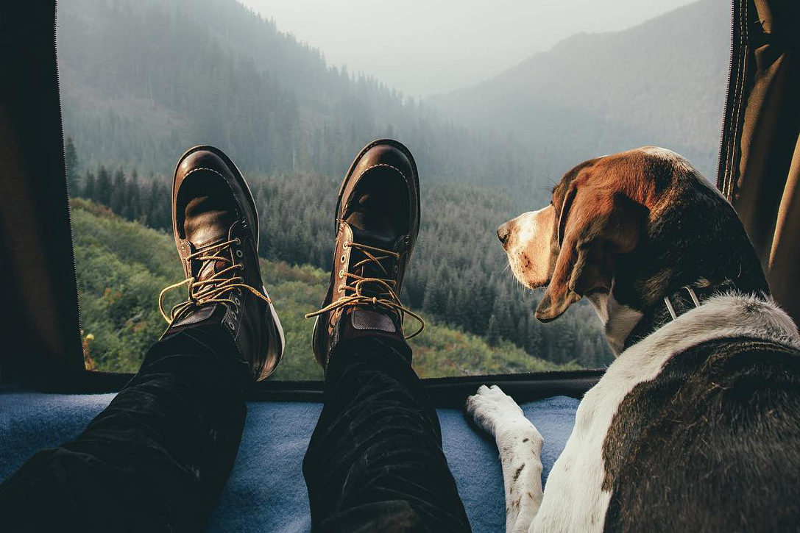
Details with PEOPLE

Slide 4
Using Details in your photos
https://digital-photography-school.com/photographing-details-in-a-scene/
Great online article and photos!

Slide 5
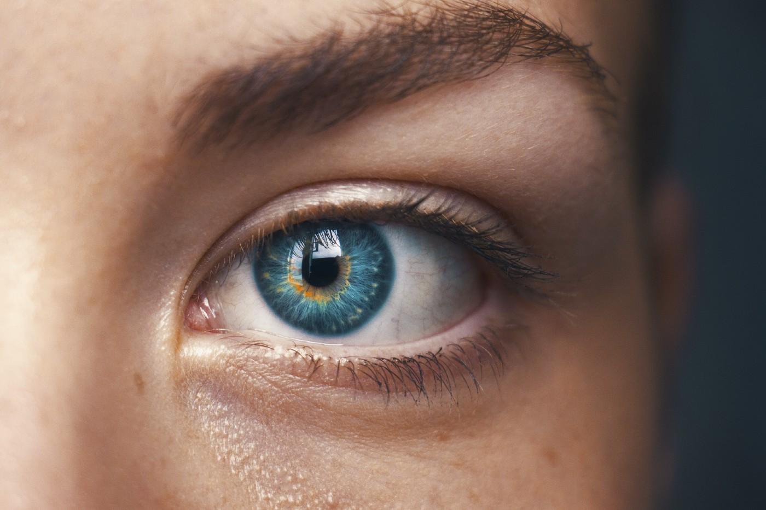
CLOSE-up

Slide 6
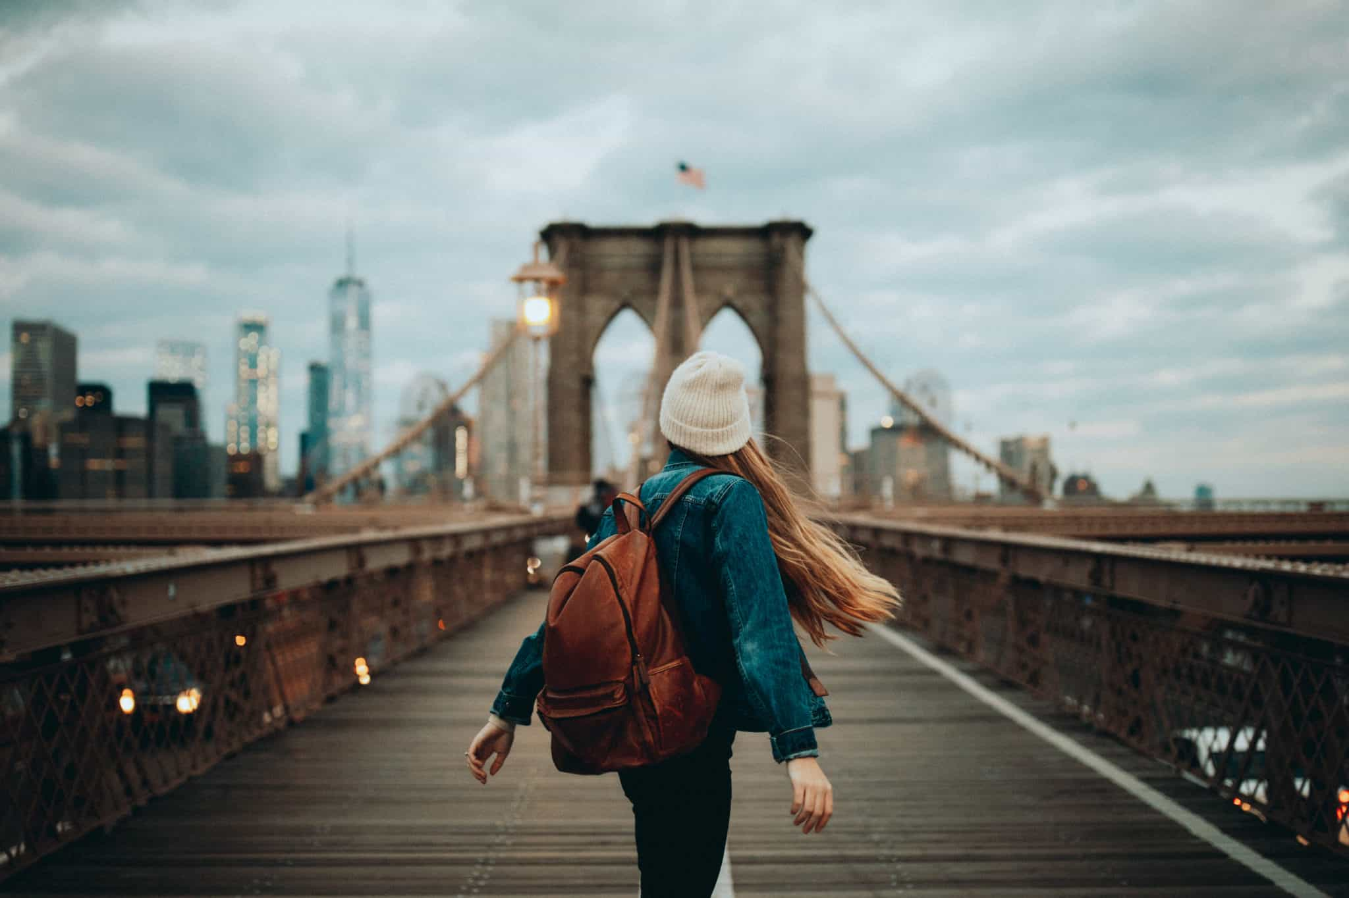
Long shot with strong foreground

Slide 7
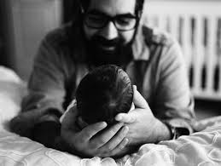
Medium shot with strong foreground

Slide 8
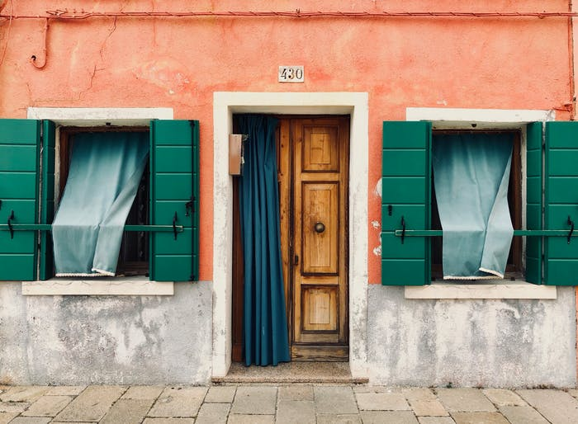
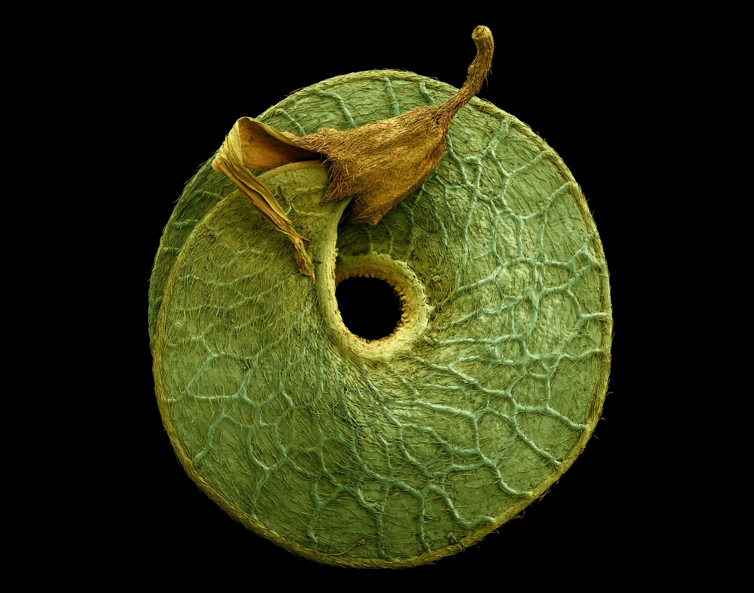
Use these composition rules:
Use of lines
Use of texture

Slide 9
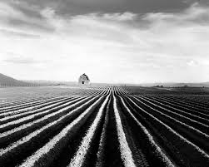

Use the composition rules:
Use of lines in nature
Use of lines with people

Slide 10
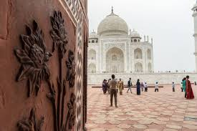
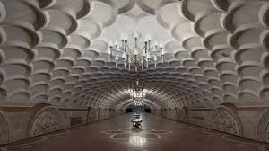
Use different horizons:
Low horizon
Medium horizon

Slide 11

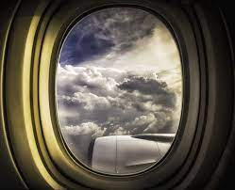
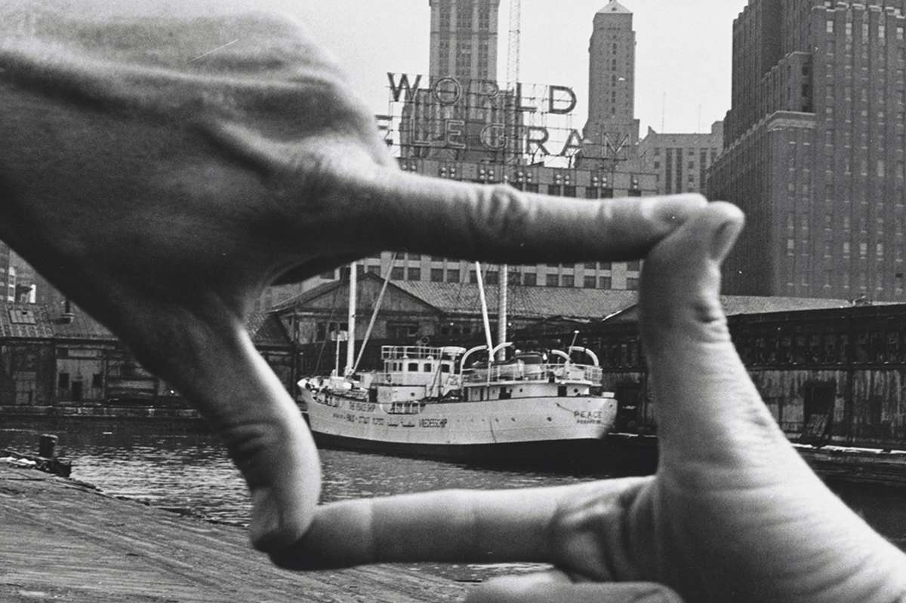
Use a frame to frame your photo:

Slide 12
For more ideas on photo compositions and on items to purchase to bring back home!
https://trip101.com/article/souvenirs-argentina

Slide 13
To prepare about visiting the ranch and eating Asado– here is Getty Photo with an array of great looking photos and compositions!
https://www.gettyimages.com/photos/gaucho-argentina?page=2&phrase=gaucho%20argentina&sort=mostpopular

