Slide 1
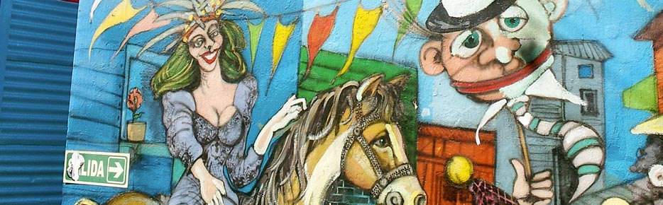
Latin American Feminisms
Wall Mural at Caminito, Buenos Aires
Central/ South America and Caribbean

Slide 2
Definition
The definition comes from a group of circumstances:
  Colonialism
  Enslavement of African peoples
  Marginalization of Native peoples
  FEMINISM then focuses on the critical work done by women fighting the previous circumstances for an equal place in society.

Slide 3
More than one type of FEMINISM, thus the plural use of FEMINISMS
More than one perspective! It becomes harder to generalize and easier to misjudge

Slide 4
Pre-20th Century
LA Feminisms
Popular Culture
The work and writings of women as “other” and “otherness”
Re-consider notions of men as the entry point of humanitity – language use here is prominently male, mankind, master and other binary considerations.
Before the 19th Century women were celebrated in non-written form but remembered in myths, songs, proverbs and oral histories.
Some are Acacaona, Baraúnda,& Garifuna women.

Slide 5
18th Century famous feminists
Sor Juana Inés de la Cruz (Mexican philosopher + Advocate for women’s intellect)
Teresa Margarida da Silva (Brazilian first woman author + Advocate for women’s interest in science and for native women)
Flora Tristrán (Peruvian + Advocate for women as workers)
Juana Manso (Argentine abolitionist + Advocate for women’s education)

Slide 6
Feminist Thoughts…before Feminism
Mexican Revolution
Brought crucial revolutionary ideas (later to be considered Feminist ideas) such as education.
Women deputies on 1916 debated the right to vote/ abortion/contraception.
Argentina’s First International Congress
  Topics included:
    PEACE
    EDUCATION
    SOCIAL PARTICIPATION

Slide 7
Women’s Rights
Puerto Rico’s Luisa Captillo
Employed as a reader in a cigar factory (unusual)
Fought for the right to vote, social class biases, gender equality and socialism
Women Suffrage (1870-1947)
Paraguay (1961)
Uruguay (1932)
Cuba (1933)
El Salvador (1939)
Puerto Rico (1935)
Argentina (1947)

Slide 8
1950-1970
Latin America goes through:
  Social unrest
  Women participation for social justice and yet not for empowering women
  Writing is compared to philosophy and thus preparing the spirit of society for social reforms.
  Women writers wrote about their gender, race, nationality, race.
NOT all women writers wrote about moving women forward and instead glorified machismo, patriarchy, and hierarchies favoring men.

Slide 9
YEARS of silence
Few women voices lead the decades of 1950-1970 for multiple reasons.
Women’s voices were pretty much left for Literature and poetry but not directly to politics or creating agency.

Slide 10
A look at “THE BODY” 1970-1990
Discourse dealing with sexual autonomy, rape, abuse, abortion, motherhood formed neofeminist perspectives among the feminists in Latina America during this time.

Slide 11
Control and Repression 1970-1990
Repression, abuse and chaos was reflective of several political systems in LA.
Motherhood took levels of political power- Co-madres(1977) in El Salvador (mothers looking for their children) Madres de la Plaza de Mayo (1977) in Argentina mothers against the state terrorism and in Mexico the Mujeres en Acción Solidaria (MAS)
Push to disconnect Motherhood from Womanhood- creating a problem for those following Marianismo but pushing for total body control by women.
Militant Feminism

Slide 12
Social Activism
Increase on
  NGOs
  Cultural groups
  Political groups against government repression
  Groups for Gender Discussion and Defense
Also more of:
  Clinics
  Abortion rights
  Feminist media (film, magazines, books)
  1981 The first Encuentro Feminista Latinoamericano y del Caribe (Bogotá, Colombia)

Slide 13
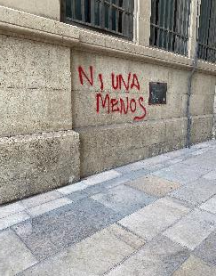
homework
Today, a woman is killed every 30 hours in Argentina. This photo on an alley is from Málaga, Spain taken in July 2021. #NiUnaMenos is a campaign started to fight against trafficking, rape and murder of women. Now in its 6th year, the #campaign traveled around the Spanish speaking countries and beyond.
Now that you know a little bit about Latin American Feminism I want you to use words and pictures to associate and represent a feeling, an opinion, an ideal that means something important to you. It could be a reflective comparison, not literal, between image and words. Even better, take a new picture for this assignment!

Slide 14
Changing times (1980s)
2 Main positions
New dynamics
1. Neither capitalism nor communism by themselves could end women’s oppression.
2. Feminism alone is not revolutionary due to its commitment to socialism. Thus, Feminism can’t be separated from class struggle.
Ever growing sentiment against homophobia, transphobia and gender bias.
Growing sentiment to understand race.
Dissolution of feminist groups coming out of church and political parties.

Slide 15
The war on HIV
Due to the immediacy of HIV/AIDS epidemic in the sexuality and sexual lives of many women—sexual politics became very conservative. Sexual narratives moved to “narratives of the risks of sex”.

Slide 16
1990s
In this decade- focused on gender equality and non-discrimination within institutions guided by neo-liberal policies.
Feminists started combining efforts with organizations that help empower women to fight violence, promote health and human rights.

Slide 17
Dissident Voices of the 2000s and beyond
Rosario Castellanos (Mexico)/ Celia Amorós (Spain) Ofelia Schutte (Cuba & US)/ María Lugones (Argentina)
A must read! Tejiendo de otro modo: feminism, espistemología y apuestas descoloniales en Abya Yala (2014)
Abya Yala in the Kuna language means “land in its full maturity” it is also used instead of “America”.

Slide 18
Current Feminist Issues
Giving voice to those voiceless with less privilege, less education, less opportunities.
Decolonial Feminism- a systemic critique of forms of power and powerless.
Depatriarchialization- resistance to capitalism, racism, homophobia and other forms of domination.
Racial and class differences that cut across the formations of identities in Latin America.

Slide 19
Resources
Bastian, Duarte, A. 2012 “From the Margins of Latin American Feminism: Indigenous and Lesbian Feminisms”, Signs: Journal of Women in Culture and Society, 38 (1): 153-178.
Connell, Raewyn, 2014 “Rethinking Gender from the South”, Feminist Studies, 40 (3): 518-539.
Kirkwood, Julieta, 1986, Ser Política en Chile: las feministas y los partidos, Santiago de Chile: FLASCO.

